Slide 1

UNIX - Fundamentals
7
Simple Filters
9
SED and AWK
5
The shell
cmp comm diff head and tail …
Inserting
Updating
Deleting
RegEx….
1
UNIX Intro
3
Unix File System
Pattern matching
Escaping Redirecting…
The UNIX OS
The Linux OS
Features of Unix
The file
pwd and cd
mkdir
ls and cp ..
Shell Programming
8
GREP
10
6
The Processes
The character class
The *
The Dot…
condition eval
loops
read
exit status
4
Vi/Vim editors
ps nohup at and batch
2
Unix Commands
Input mode
Saving text
Aborting…
command basics
man
echo
printf …
Biz Nigatu
Software Engineer and Instructor
reckonedforce.com
@bizNigatu

Slide 2
Section 2 – UNIX Fundamentals
vi Editor
.bashrc File
history command
Case sensitivity
structure of Unix commands
head and tail commands
ls, pwd, ps, touch, cp commands
Different Unix Shells
Pipes
Manual pages (man command)
echo, echo -e and printf commands
rm and rmdir commands
uname and passwd commands
who and who am i commands
date command
stty command
sort command
unique command
color prompts for your shell
introduction to shell script structure
diff and comp commands
Redirection
cat
Three destinations of standard output

Slide 3
Chapter 5: The vi Editor

Slide 4
The Main UNIX/Linux Editor vi
Created for BSD UNIX
Commands are cryptic and mnemonic
Operates in three modes
Command mode – default mode where every key pressed is interpreted as a command to run on text
Navigation, copying, and deleting text are performed in this mode
Use ‘h’ and ‘l’ to move cursor along a line
Input mode – editing mode
Ex mode or Last Line Mode – used for file handling and performing substitutions
vi originally hard-linked to a line editor named ex; were this mode got its name from

Slide 5
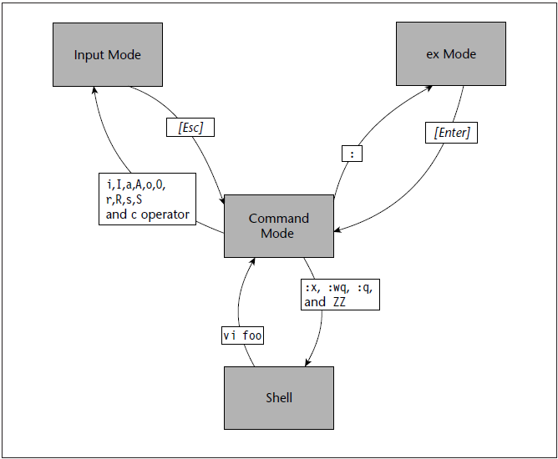
Three vi Modes

Slide 6
Cursor Movement Commands in vi (& vim) Master title style
Key | Does the Following
Down Arrow | Moves the cursor one line down
Up Arrow | Moves the cursor one line up
Left Arrow | Moves the cursor one character to the left
Right Arrow | Moves the cursor one character to the right
W | Moves the cursor one word forward
B | Moves the cursor one word backward
CTRL-D | Moves down half a screen
CTRL-U | Moves up half a screen
$ | Move to end of line
You can go to a specific line number at any time by using the colon (:) command. For example, to go to line 6, type ‘:6’ and press enter. vi displays the colon on the last line of the screen and from then on, vi uses any text you type as a command. You have to press enter to submit a command to vi.
To search for a string, first type a slash (/), which is displayed on the last line of the screen. Type the search string and then press enter. The vi editor locates the string and positions the cursor at the beginning of that string.

Slide 7
Commonly Used vi Commands (1)
Command | Does the Following
Insert Text
a | Inserts text after the cursor
A | Inserts text at the end of the current line
I | Inserts text at the beginning of the current line
i | Inserts text before the cursor
Delete Text
D | Deletes up to the end of the current line
dG | Deletes from the current line to the end of the file
dw | Deletes from the cursor to the end of the following word
x | Deletes the character on which the cursor rests
Change Text
C | Changes up to the end of the current line
Cc | Changes the current line
J | Joins the current line with the next one
Rx | Replaces the character under the cursor with x (where x is any character)

Slide 8
Commonly Used vi Commands (2)
Command | Does the Following
Move Cursor
h or left-arrow | Moves one character to the left
j or down-arrow | Moves one line down
k or up-arrow | Moves one line up
L | Moves to the end of the screen
l or right-arrow | Moves one character to the right
w | Moves to the beginning of the following word
b | Moves to the beginning of the previous word
Scroll Text
CTRL-D | Scrolls forward by half a screen
CTRL-U | Scrolls backward by half a screen
Refresh Screen
CTRL-L | Redraws screen
Cut & Paste Text
yy | Yanks (copies) the current line into an unnamed buffer
P | Puts the yanked line above the current line
p | Puts the yanked line below the current line

Slide 9
Commonly Used vi Commands (3)
Command | Does the Following
Colon Commands
:! command | Executes a shell command
:q | Quits the editor
:q! | Quits without saving changes
:r filename | Reads the file and inserts it after the current line
:w filename | Writes a buffer to the file
:wq | Saves changes and exits
Search Text
/string | Searches forward for a string
?string | Searches backward for a string
Miscellaneous
u | Undoes the last command
U | Undoes recent changes to the current line
ESC | Ends input mode and re-enters visual command mode
G | Go to the end of the file

Slide 10
.bashrc File
alias la='ls -A’
alias l='ls -CF’
alias ll="clear ; ls -lgF | sed '1d’”
alias ls='ls -x'alias
cls=clear
alias cd..='cd ..’
alias dir='ls -algF’
alias md=mkdir
alias rd=rmdir
alias mv='mv -i’
alias cp='cp -i’
alias rm='rm -i’
alias h='history | tail -n25’
alias pt="ps -u nick | tail“
alias vi='vim’
alias del=rm
alias s="{ cd /home/nick/scripts ; }“
alias bus='cd /home/nick/databases/bus’
alias cars="{ cd /home/nick/databases/cars ; }“
alias sf="{ cd /media/sf_Ubuntu ; }"
Aliases are simply that, what YOU want to run that, in fact, means something else.

Slide 11
.bashrc File
.bashrc is a shell script that Bash runs whenever it is started interactively. It initializes an interactive shell session. You can put any command in that file that you could type at the command prompt.
set -o ignoreeof
set -o noclobber
PS1="${debian_chroot:+($debian_chroot)}\[\033[01;31m\]\u\[\033[01;37m\]@\[\033[01;32m\]\h\[\033[01;36m\] \w\[\033[00m\] \$ “
PS2='continue: '
Note: Look at page 78 to see the color coding works for PS1

Slide 12
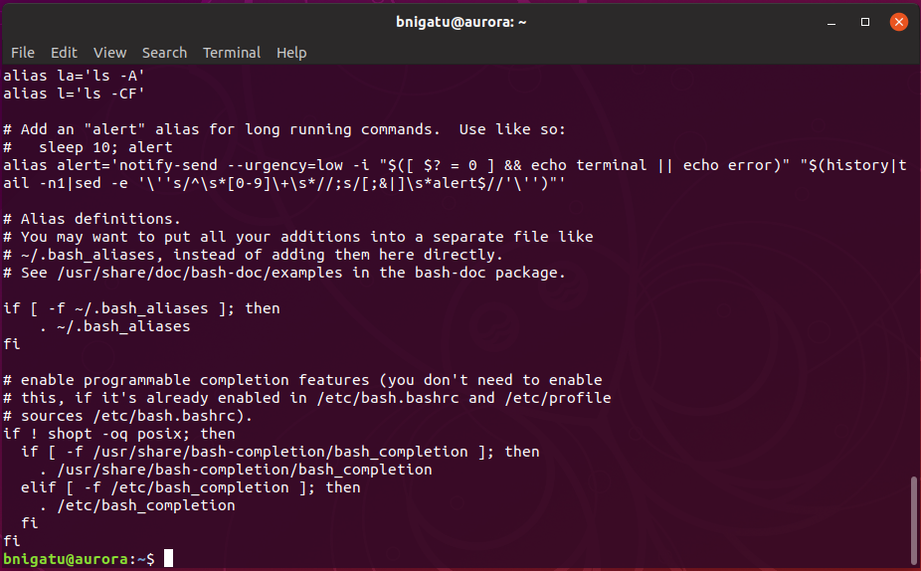
Example

Slide 13
Chapter 3 - Becoming Familiar with UNIX Commands ***

Slide 14
‘history’ Command
Most shells, (except the Bourne shell) can save your past commands
You can replay those commands
In most shells you can edit the commands to do other things
This is a major efficiency savings

Slide 15
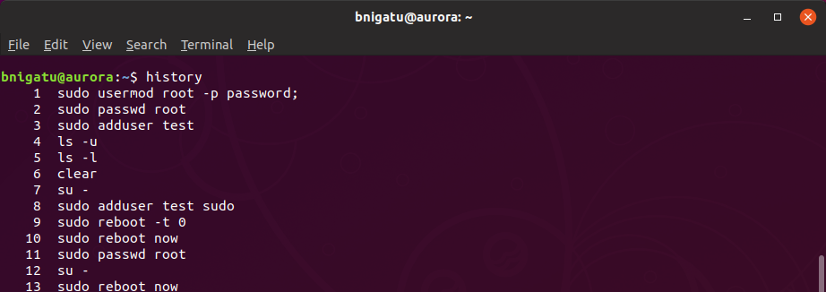
Using ‘history’
In the bash shell you invoke history by pressing the up arrow
You can also type ‘history’
History is a history of all the commands you have typed into the shell
History is a powerful tool for recalling/editing past commands

Slide 16




Editors
This is sometimes a “Holy War”
In the 80s and 90s
Young Turks - liked emacs and, sometimes, vi
KISS folks - liked pico and gedit
Classics - support the traditional editors:
ed (won’t use),
ex (won’t use),
vi (will learn),
vim (will learn)

Slide 17
Case Sensitivity
Substandard Operating Systems think AFILE and afile are the same file
True Operating Systems recognize that ‘a’ and ‘A’ are different
Unix and Linux are true operating systems :-)
Lower case is easier to read than ALL UPPER CASE LETTERS
Use lowercase

Slide 18


How Unix looks at You
Unix thinks you are a cognizant adult
Unix believes you know what you are doing
Unix will do what you tell it without insulting you by asking if you are sure
Unix doesn’t prevent you from doing incredibly stupid things because that would also prevent you from doing amazingly clever things

Slide 19
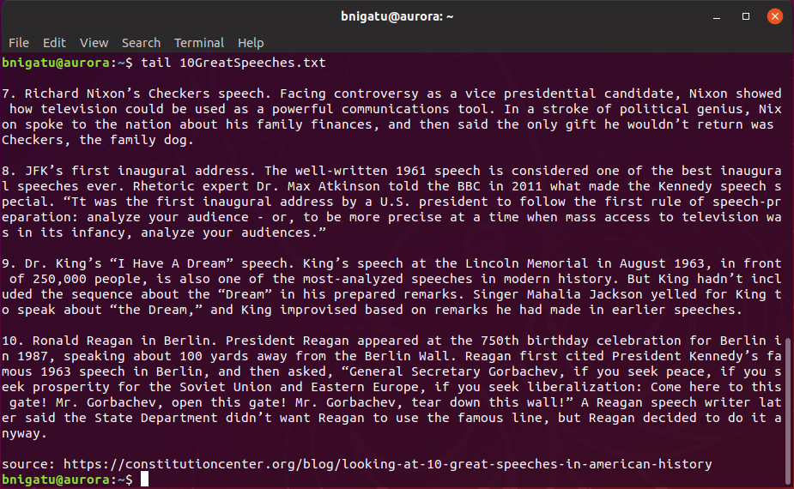
‘tail’ Command
Shows the last 10 lines of a file by default
option allows more or less lines
used to check last few lines of a file w/o scanning the whole file
tail -f
checks every second
shows end of file as file grows

Slide 20
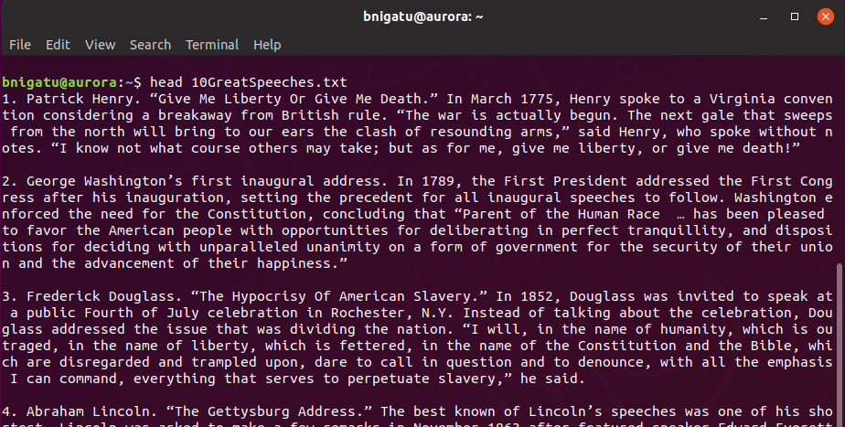
‘head’ Command
Shows first 10 lines of file by default
option allows for more or fewer lines
useful for looking at the first few lines of a script (where good documentation lives!)

Slide 21
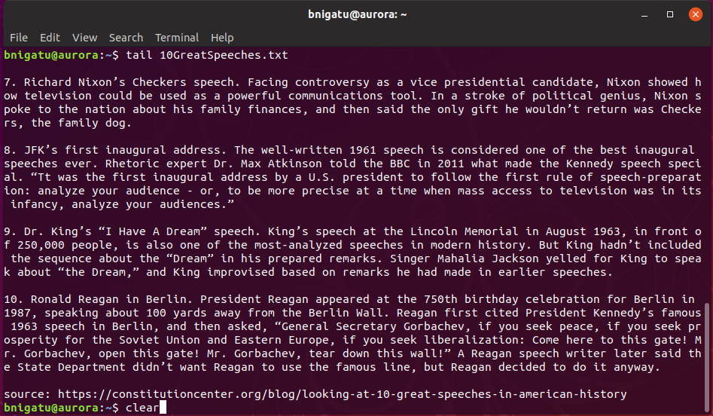
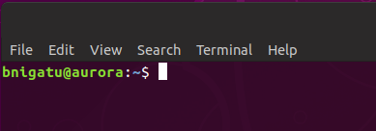
‘clear’ Command
Before running clear
After running ‘clear’

Slide 22
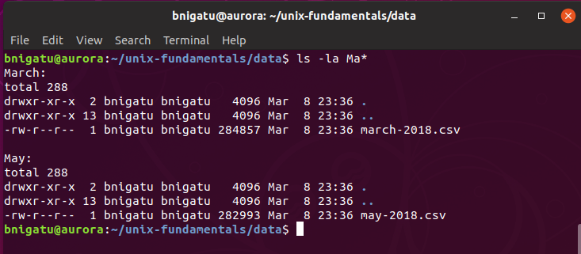
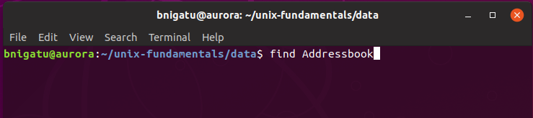
Arguments
These tell the command what to work upon.
For example:
‘ls -la Ma*’ tells the ls command to find files that start with “Ma”
Addressbook is an argument

Slide 23
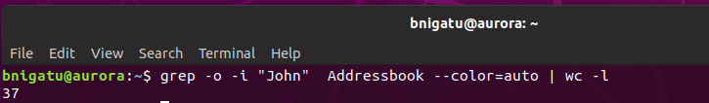
Options
Modify how the command works
Are usually preceded by a hyphen
can be combined behind one hyphen, i.e. ls -al
must be separated from the command by white space

Slide 24
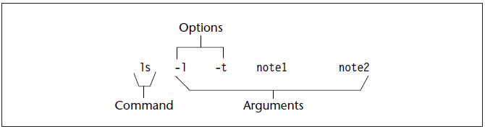
‘ls’ Syntax for list Command
Structure of a UNIX Command

Slide 25
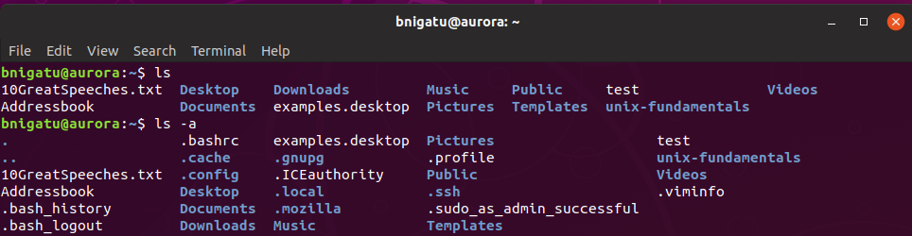
‘ls’ Command
The list command – abbreviated or full listing
‘ls’ without any arguments just shows a sorted listing of files and directories.
‘ls –a’ include hidden directories or whose name begins with (.)

Slide 26
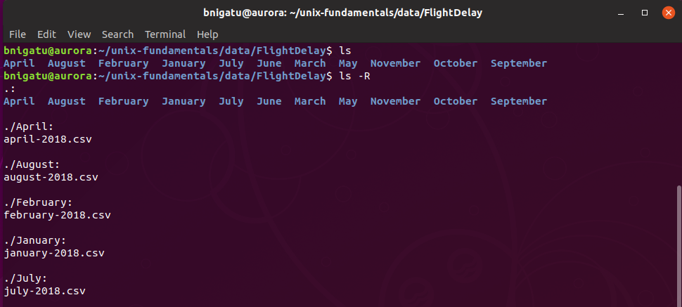
Recursive ‘ls -R’
‘-R’ Recursively list subdirectories encountered.

Slide 27
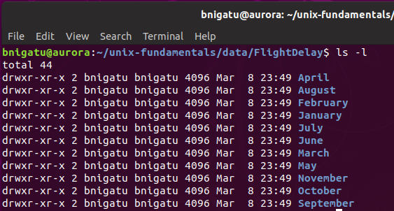
Long Listing ‘ls –l’
Shows a full listing of a file along with owner, group, date, and permissions

Slide 28
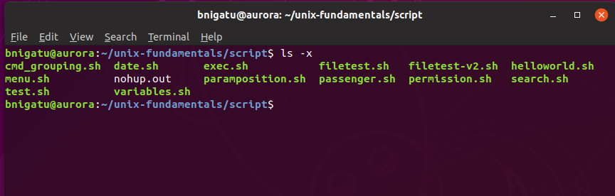
Sort across ‘ls –lx’

Slide 29
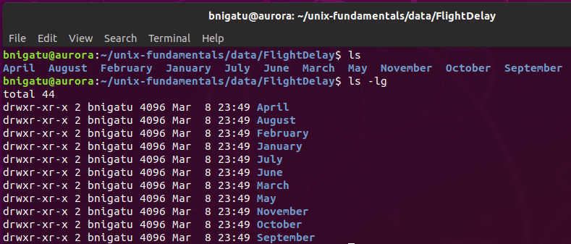
Hide Group ‘ls –lg’
-g: List in long format as in -l, except that the owner is not printed.

Slide 30
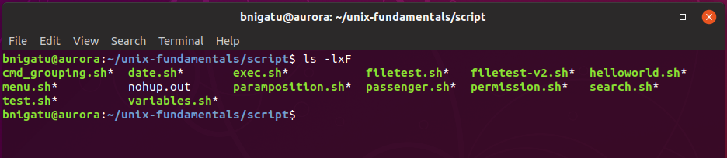
Show Executable ‘ls –lxF’
Note: the –l (long listing) option cannot be used with the –x (columns) option;
it can be used with the –F and only –F shows executables

Slide 31
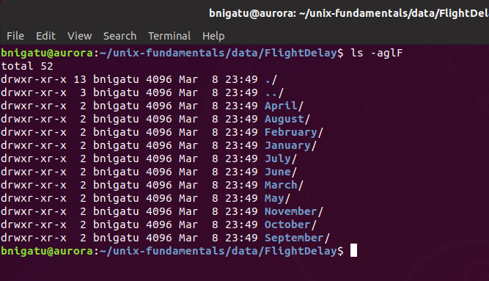
Full Listing without Group

Slide 32
Useful Keys
^C (Ctrl-C ) kills the current process
^Z (Ctrl-Z) puts the current process to sleep
^D (Ctrl-D) marks the end of an input file, most often used when sending input from the command line
<ENTER> sends a newline
Backspace erases the character just in front of the cursor.

Slide 33
Common UNIX/Linux Commands
Unlike MS-DOS where uppercase and lowercase are the same, Unix and Linux are case sensitive
pwd is not the same as PWD (error)
pwd (print working directory)
‘pwd’
‘cd /dev’
‘pwd’
ps (processes)
‘ps –au’ (show all (-a) for user (u)
Should display
‘ps –A’ (show ALL processes running)

Slide 34
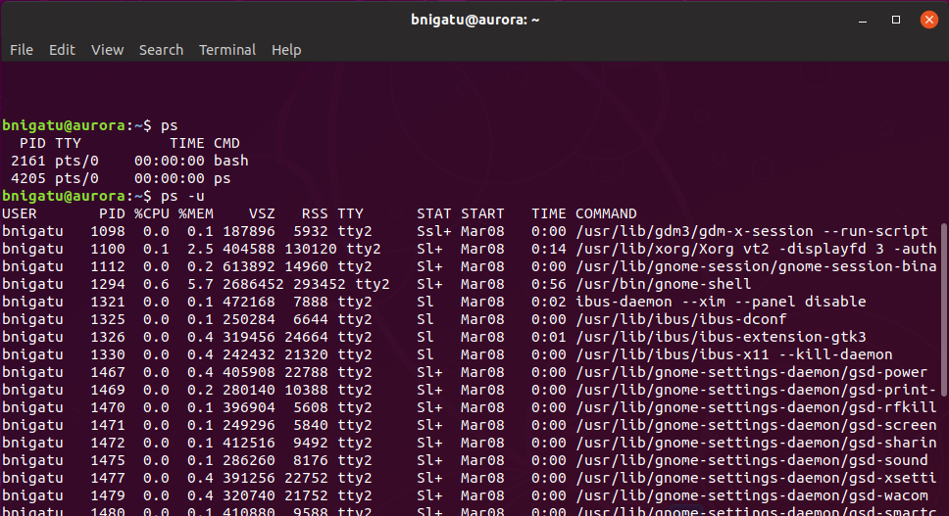
Common UNIX/Linux Commands
Running the ‘ps -u’ in the desktop versus server gives quite a lot more processes

Slide 35
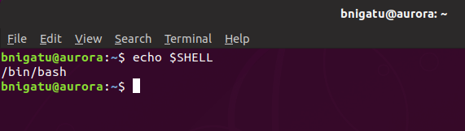
Different Shells
sh (Bourne shell)
csk (C shell)
ksh (Korn shell)
bash
Type ‘echo $SHELL’ – the ‘$’ signifies a variable
‘echo’ means print out to the standard output (STDOUT)

Slide 36
‘touch’ Creating Empty Files
‘cat > filename’ (will create a file and enable you to enter data)
<CTRL-D> to save and exit
<CTRL-C> to exit without saving
‘cat <filename>’ to display contents of <filename>
‘echo date > file2’
This will redirect the word ‘date’ to file2
To print out the actual date, type echo `date` > file2
echo and date accepted an argument
Using ‘cat’ is just one method for creating files and inputting data – think of it as the ‘quick and dirty’ method.
Called a back tick (located under the ~. The back tick RUNS the command date and redirects the output to file2.

Slide 37
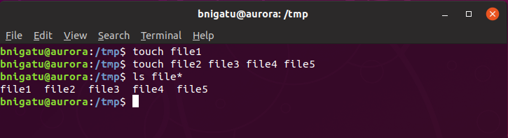
‘touch’ Creating Empty Files
The ‘touch’ command was designed to refresh files, e.g. if you had several files with an older date, touching them would change the date to the current date
Using ‘touch’ on non-existent files will create an empty file

Slide 38
‘cp’ Copying Files
‘cp tmp2 tmp3’ (copy file tmp2 to file tmp3)
cat tmp3 (display the contents of tmp3)
To copy an entire directory structure:
‘cp –r temp temp2’
Temp and temp2 are directories.
The ‘-r’ option means recursive

Slide 39
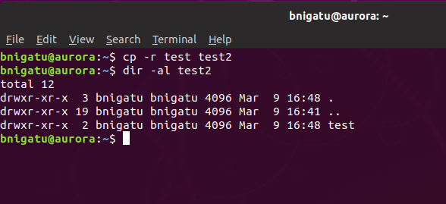
‘cp’ Copying Files Continued
This command makes a duplicate of the ‘test’ directory.
The ‘-r’ makes sure that all subdirectories are copied as well.
test2 did not exist before the ‘cp’ command.

Slide 40

‘pipe’ Command
As discussed earlier, Unix/Linux uses a modular approach – the output of one command can be the input to another
Output of who is input to wc
Lines
Words
Characters

Slide 41
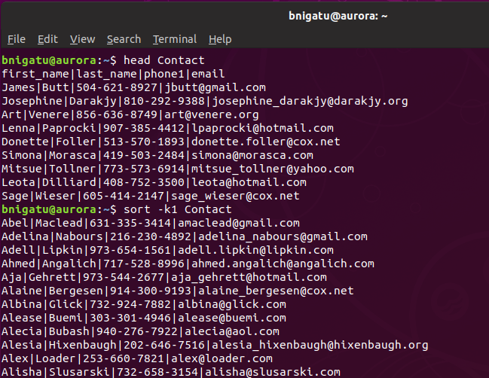
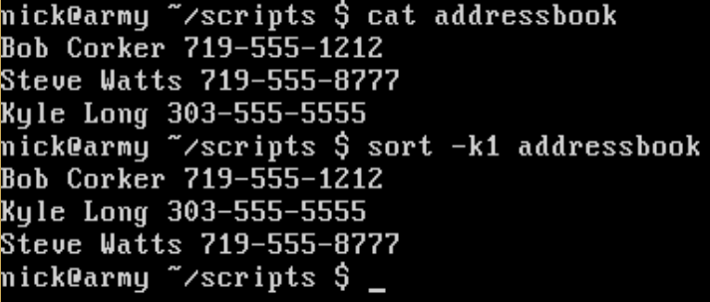
‘pipe’ Command
Sort needs to sort on something so it has an argument. In this case, the argument is Contact.

Slide 42
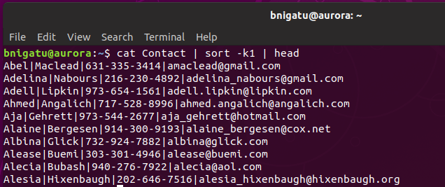
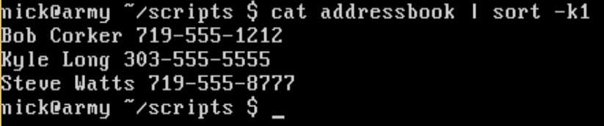
‘pipe’ Command example
No input file
Another pipe No input file again
In this example, cat is used to display the contents of the file ‘Contact’. However, since we have a pipe, the contents are not displayed on the screen but used as the input to the sort command. Thus, sort does not require an argument. To limit the number of lines we display we have used another pipe with head

Slide 43
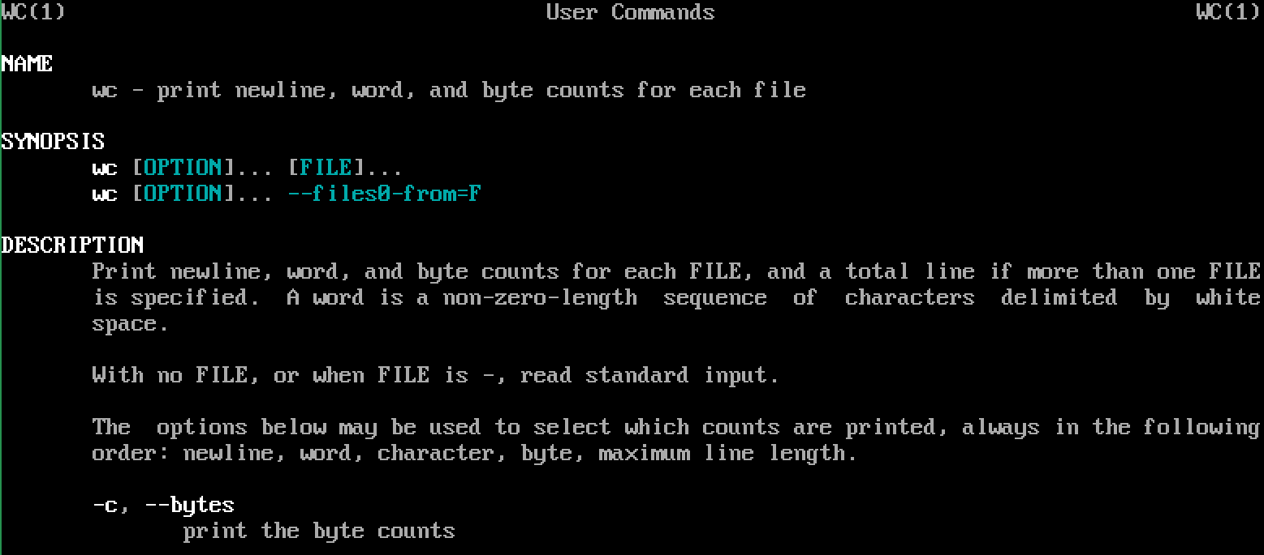
‘man’ Manual Pages
‘man wc’ will display the manual page for ‘wc’ to the screen

Slide 44
‘man’ Manual Pages (continued)
Manual pages will display a portion of the manual on screen and then will pause
You can continue or quit
‘man’ uses ‘more’ while Linux uses ‘less’ – known as pagers
‘more’ displays one page at a time
Try these commands:
‘man wc > wc_manual’
‘more wc_manual’
‘man –k wc’ – this is more extensive and will display everything with ‘wc’
Also called ‘apropos’
‘apropos –k wc’

Slide 45
‘echo’ Command
We’ve used ‘echo’ earlier, now we’ll expand on it
echo is used in Windows Command .BAT files and echo in the PHP programming language
‘echo’ comes from UNIX and they all perform the same function – print something
Enter:
‘echo “Filename not entered” ’ (technically, don’t need the quotes)
echo Filename not entered (works as well)

Slide 46
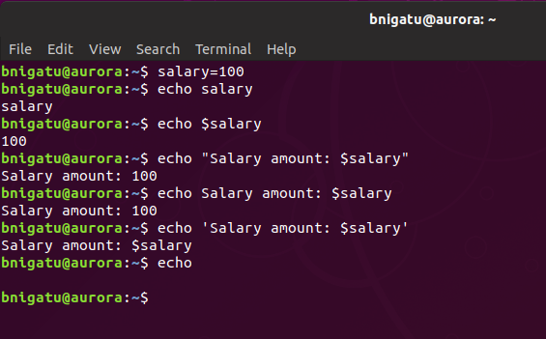
‘echo’ Command (example)
variable

Slide 47
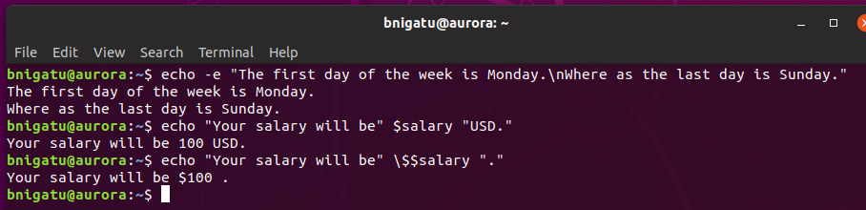
‘echo’ Command
\n is a newline; the \ translates to a literal double-quote. The \ is an escape character.
More examples:
\ protects the $ because the $ is a metacharacter and is used to define a variable.

Slide 48
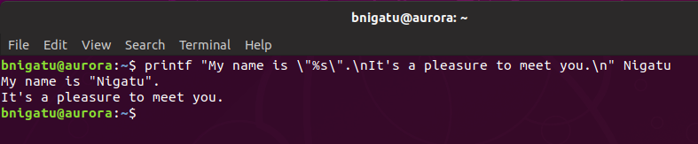
‘printf’ Command
The ‘printf’ command allows for more customized formatting that what is allowed with ‘echo’
Syntax:
printf FORMAT [argument]
printf OPTION
Examples:
Print a string variable
With printf, \n does print a newline
String variable

Slide 49
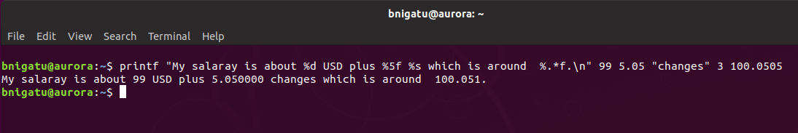
‘printf’ Command ***
Example continued
%d means decimal value
%5f means floating point to 5 levels of accuracy

Slide 50
‘printf’ Conversion Specifications
Each conversion specification begins with a % and ends with a conversion character
Between the % and the conversion character, there may be, in order:
- | A minus sign tells printf to left-adjust the conversion of the argument; normal is right.
number | An integer that specifies field width; printf will print a conversion of ARGUMENT in a field at least number characters wide. If necessary, it will be padded on the left (or right, if left-adjustment is called for) to make up the field width.
. | A period, which separates the field width from the precision. The field is not expanded when the text is longer, the text is truncated instead.
number | An integer, the precision, which specifies the maximum number of characters to be printed from a string, or the number of digits after the decimal point of a floating-point value, or the minimum number of digits for an integer.
h or l | These differentiate between a short and a long integer, respectively, and are generally only needed for computer programming.
* | The width is given as an argument before the string or number; * corresponds to “20”.

Slide 51
‘printf’ Conversion Specifications
0 | Pads numbers with zeros, not spaces
<space> | Pad a positive number with a space, where a minus (-) is for negative numbers
+ | Prints all numbers signed (+) for positive and (-) for negative numbers
<N> | Any number: specified the minimum field width, if the text is shorted, it’s padded with spaces, if longer then the field is expanded.

Slide 52
‘printf’ Command
‘printf’ requires the number of conversion strings to match the number of ARGUMENTS; it maps them one-to-one and expects to find exactly one ARGUMENT for each conversion string
Conversion strings are ALWAYS interpreted from left to right
‘printf’ is the successor for ‘echo’ and has far more features

Slide 53
‘printf’ Command
The conversion characters themselves tell printf what kind of argument to expect:
Conversion Character | Argument Type
d, I | An integer, expressed as a decimal number.
o | An integer, expressed as an unsigned octal number.
x, X | An integer, expressed as an unsigned hexadecimal number.
u | An integer, expressed as an unsigned decimal number.
c | An integer, expressed as a character, corresponding to the ASCII code.
s | A string
f | A floating-point number, with a default precision of 6
e, E | A floating-point number expressed in scientific notation, with a default precision of 6
p | A memory address pointer
% | No conversion; a literal percent sign (“%” is printed instead

Slide 54
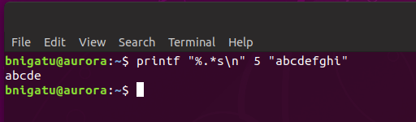
‘printf’ Conversion Specifications
A width or precision may be represented with an asterisk (“*”); if so, the asterisk reads in an argument, which must be an integer, and uses that value:
Width or precision of argument

Slide 55
‘printf’ Command
FORMAT string | ARGUMENT string | output string
“%s” | “computerhope” | “compouterhope”
“%8s” | “computerhope” | “computerhope”
“%.8s” | “computerhope” | “computer”
“%-8s” | “computerhope” | “computerhope”
“%-15s” | “computerhope” | “computerhope “
“%15.8s” | “computerhope” | “ computer”
“%-15.8” | “computerhope” | “computer “
“%-15.2” | “computerhope” | “co “

Slide 56
‘printf’ Escape Characters
\” | Prints a double-quote (“)
\\ | Prints a backslash (\)
\a | Issues an alert (plays a bell)
\b | Prints a backspace
\c | Instructs printf to produce no further output
\e | Prints an escape character (ASCII code 27)
\f | Prints a form feed
\n | Prints a newline
\r | Prints a carriage return
\t | Prints a horizontal tab
\v | Prints a vertical tab

Slide 57
More on Files and Directories
Removing files is easy:
To remove tmp3, enter ‘rm -i tmp3’ – the –i argument means to ask you first to verify (rm = remove)
To remove all files: ‘rm *’ – doesn’t include ‘.’ files
Directories are ordinary files in UNIX and Linux
Every file has an association with a directory
To create a directory, enter ‘mkdir temp’ (mkdir = make directory)
Now, type ls –alF to see the directory you just created
Removing a directory is a little different:
Enter ‘rmdir temp’ (rmdir = remove directory)

Slide 58
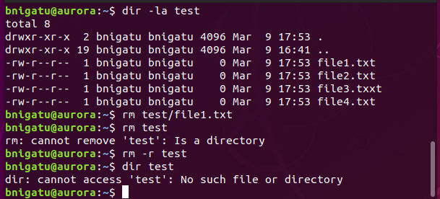
More ‘rm’
rm will not delete a directory such as ‘rm test’
Will result in an error
To delete a directory, all of its files, and any subdirectories, use: ‘rm –R <DIR>’ or ‘rm –r <DIR>’

Slide 59
More on Files and Directories
The mv command moves files from one location to another
Cannot rename multiple files from one extension to another
Let’s create a directory called ‘temp’
Now let’s move to that directory: ‘cd temp’
Let’s create a simple file: ‘cat date > tmp4’
Now move it to the previous directory:
‘mv tmp4 ..’
View the file move: ‘ls ..’
The ‘.’ and ‘..’ mean the same as they do in MS-DOS: ‘.’ = current directory and ‘..’ = previous directory

Slide 60
More Basic Commands
The ‘mv’ command is also used to rename a file:
‘mv tmp3 tmp5’
Or to move files from one directory to another:
‘mv ../* .’ (move all files from parent to current)
Unlike MS-DOS that uses the backwards slash, UNIX and Linux use the forward slash (/)
Switching to the /etc directory is simple: ‘cd /etc’
To return to your home directory: ‘cd’

Slide 61
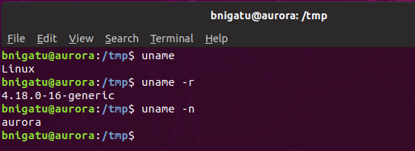
‘uname’ Command
The ‘uname’ command displays certain features of the OS running on your machine. By default, it only lists the OS
KERNEL
MACHINE NAME

Slide 62
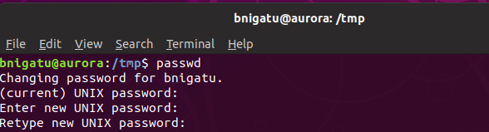
‘passwd’ Command
The ‘passwd’ command is used to change your password

Slide 63

‘passwd’ Command (continued)
Changes the password for the user running the command New password is encrypted by the system and stored in the file /etc/shadow (or /etc/passwd on older systems)
Many systems conduct certain checks on the password string to ensure that you don’t choose easy-to-remember passwords. Systems often insist on a minimum length or a mix of letters and numerals

Slide 64
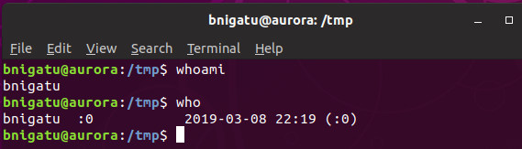
‘who’ & ‘whoami’ Commands
The first column shows the user-id on the system
The second column shows the filenames of the devices associated with the respective terminals
The 3rd, 4th, & 5th columns show the date & time of logging in

Slide 65
’date’ Command
Display the current date with ‘date’
Print only the month with ‘date +%m’ (in numeric)
Print only the month with ‘date +%h’ (month name)
Or combine them: ‘date +”%h %m”
d – day of the month
y – last two digits of the year
H, M and S – hour, minutes, and seconds
D – mm/dd/yy
T – the time in the format hh:mm:ss

Slide 66
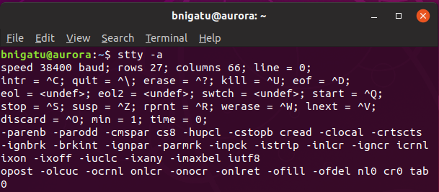
‘stty’ Command
Different terminals have different characteristics
The stty command changes terminal settings and displays them when used with the ‘-a’ option

Slide 67
‘stty’ Command (continued)
Interrupt a command (intr)
‘stty intr DEL’ makes the delete key the command interrupt key
To change back, ‘stty intr \^c’

Slide 68
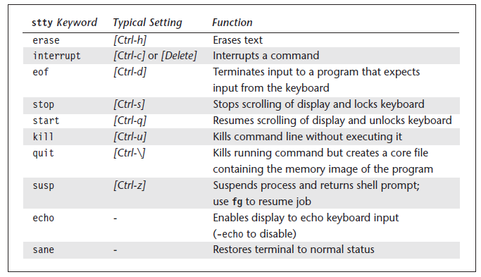
‘stty’ Command (continued)
stty Settings and Keyboard Commands to Try When Things Go Wrong

Slide 69
’sort’ Command
An extremely important tool in olden times.
Now a useful tool in many applications
Need to specify a key field or fields to sort on, by default sort uses the whole record
Most sorts are alphabetic, must specify if you want a numeric sort
Can also use sort to merge two previously sorted files

Slide 70
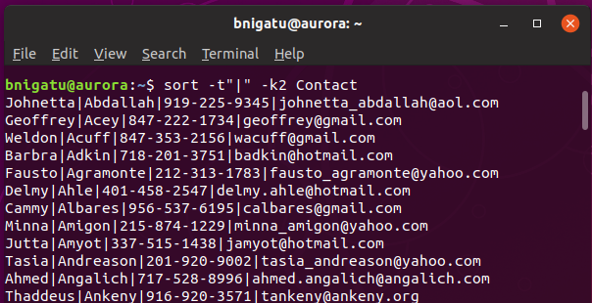
’sort’: Key Fields
The ‘-k’ option tells sort which field you want to sort on; however, you must tell sort HOW to determine what is a field.
The ‘-t’ option tells sort what defines a field

Slide 71
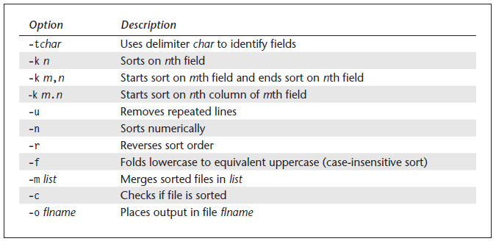
Sort: Options
There are several useful options besides –k & -t

Slide 72
Sort: options (continued)
Looking at your data the first column is column 0, the second is column 1, the third is column 2, etc.
To sort this way use the + sign
sort +2 filename.ext will sort on the third column
To sort numerically correct you would add the n switch. i.e.; sort +2n filename.ext

Slide 73
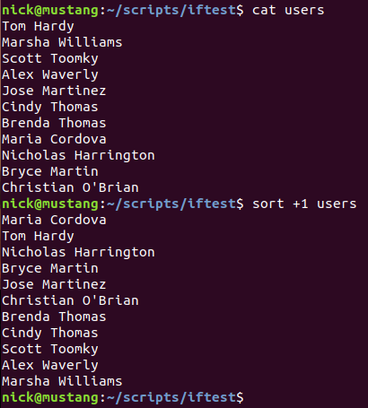
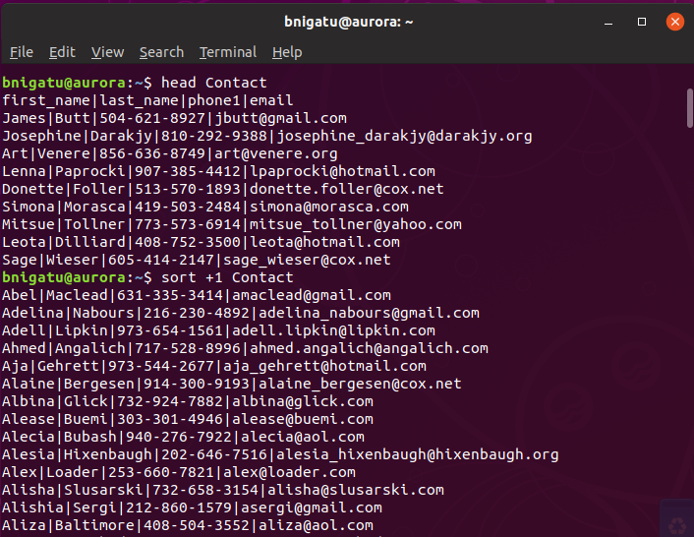
If a file uses the default space between field then you can use this example, e.g. ‘sort +1’ or some other field value.

Slide 74
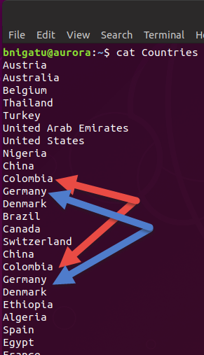
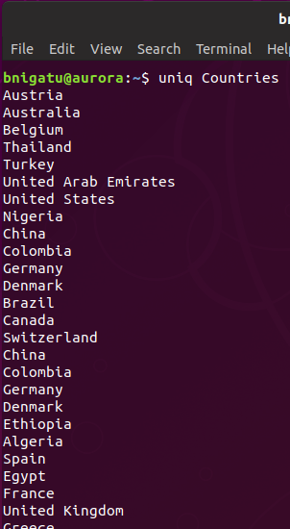
Uniq Command
Syntax: uniq [options] [input[output]]
Compares lines in a sorted file
Only the adjacent lines are compared
Default output is a file which only has one copy of each line
If output is not specified, stdout is used

Slide 75
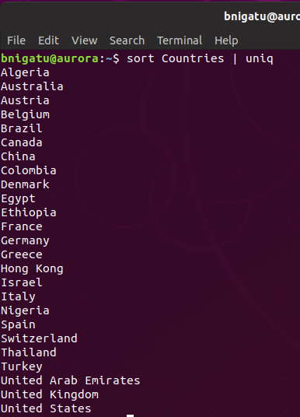
Unique
The previous uniq command did not work because it is not a sorted list.
However, we can sort and pipe it the result to uniq

Slide 76
Color Prompts
If you are operating in a change root environment, the prompt will be modified to remind you
user name
Color and ‘\’ codes {\u (user name), \h (host name), \w (working directory)}
BOLD
RED

Slide 77
Foreground Colors
FOREGROUND Base Colors CODES | Color
30 | Black
31 | Red
32 | Green
33 | Yellow
34 | Blue
35 | Purple
36 | Cyan
37 | White
ATTRIBUTE Color CODES | Color
0 | Normal Text
1 | Bold or light depending upon terminal text
4 | Underlined text

Slide 78
Background Colors
BACKGROUND Base Colors CODES | Color
40 | Black
41 | Red
42 | Green
43 | Yellow
44 | Blue
45 | Purple
46 | Cyan
47 | White

Slide 79
Examples ***
Colors must start with \[\e or \[\033 – 033 isn’t the actual start of a color but the command that a color code is forthcoming
\[\033[4;32m\]
The 32 is the color green. After the color code, you must follow with the ‘m’. The UNDERLINED attribute

Slide 80
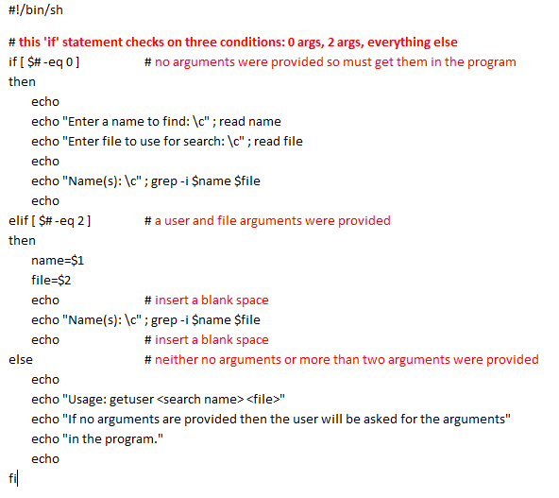
Shell scripts that use shell script-specific commands start with:
#!/bin/sh or #!/bin/bash
#!/bin/bash uses some commands similar to C/C++.
This is a simple if this is true then do this otherwise do this command.
[ $# -eq 0 ] = test
$# means total number of arguments given. Thus, if the total number of arguments = 0 then do this.

Slide 81
‘diff’ Command
Syntax: diff [option] dir1 dir2
diff [options] file1 file2
Produces a listing showing differences between file1 and file 2
“<“ refers to lines in file1
“>“ refers to lines in file2
Returns a non-zero exit status if the files differ.

Slide 82
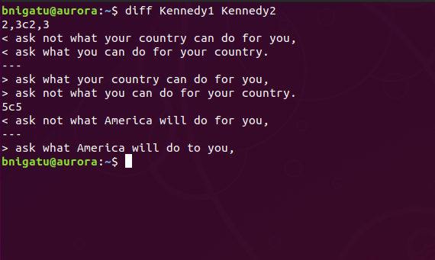
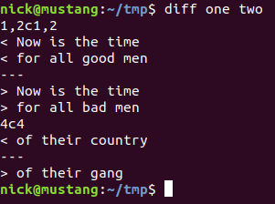
‘diff’ Command Example
There are four lines in each file. The second and fourth lines are different.
2,3c2,3 means a change needs to occur between lines one and two of both files.
Line three is a match so it is omitted.
5c5 means the fourth line of both files is different.
There are differences between lines 2 and 3 of both files
Line 5 is different on both files

Slide 83
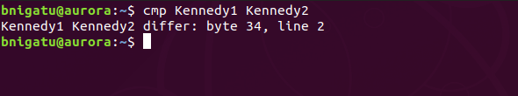
‘cmp’ Command
cmp [-l-s] file1 file2
Compares two files (even binary) to determine where different
Normally exits on finding the first byte which is different
The -s option is silent and returns a non-zero exit status if the files are different.
Will report offset if difference is found. Report is silent if files match

Slide 84
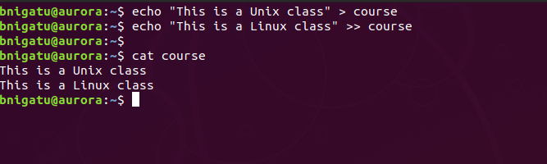
Redirection
If you want to redirect standard out to a file, it doesn’t matter which shell you are in, you just use the >, and the shell will redirect the output to the file.
> means redirect and overwrite
>> means redirect and append
Send output to a new file, e.g. create a new file
Send output to the end of a file

Slide 85

Cat Command
Concatenation (of two or more files or a single file and standard out.)
Often used to view short files
Can be used to combine files with redirection of output
Can also be used to create short files

Slide 86


The Three Destinations of Standard Output
To File
To Screen
To Pipe

Slide 87
Things to Know
In Unix and Linux, successful commands operate silently, e.g. they work and you get the prompt
If they fail – you get an error.
Some commands, like ‘tar’ (similar to zip) have a verbose argument

Slide 88
Setting Up Environment
First, we’re going to customize your prompt and setup any aliases that will make life easier for you
The first step is to make a copy (backup) of the .bashrc file
‘cp .bashrc .bashrc.old’
Then we’re going to run the vi editor on .bashrc
‘vi .bashrc’

Slide 89


.bashrc file
Prompt Strings – there are four but PS3 & 4 are for the Korn shell.
Some of my aliases
PS1 is used for a custom shell prompt
PS2 is used continuation, e.g. when you issue an incomplete command, the shell will go to the next line and wait for you to complete the command. There usually is nothing but you can add a custom prompt.

